Slide 1
TOPIC
Nano-Technology In
Cancer Treatment

Slide 2
GROUP MEMBERS
Rupam Chakraborty
Srikrishna Mandal
Suranjan Chatterjee
Debjyoti Pal

Slide 3
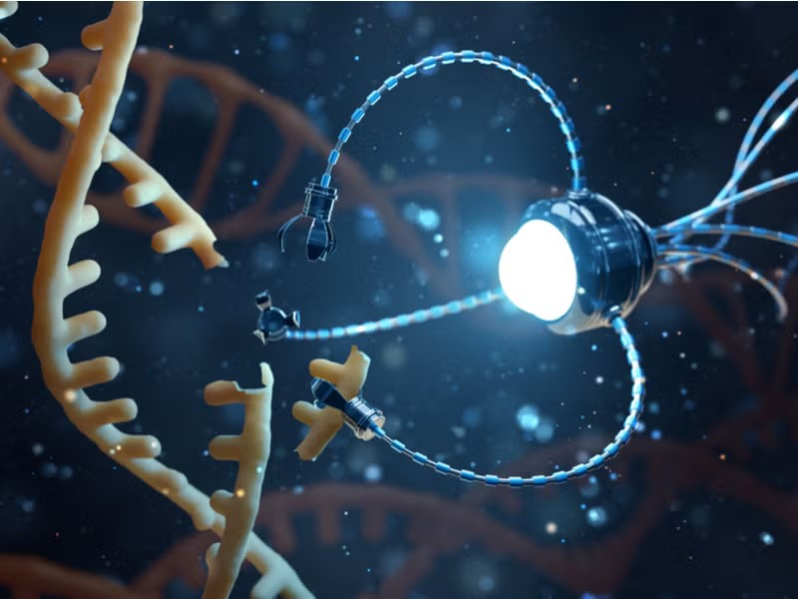
What is Nanotechnology
Nanotechnology deals with extremely tiny materials, usually 1–100 nanometers in size.
At this nanoscale, materials behave differently — they can become more reactive, stronger, or show unique physical properties.
In medicine, these tiny particles can enter cells, interact with molecules, and move through the body more easily than larger materials.
Nanotechnology helps create better drug-delivery systems, sharper imaging tools, and more sensitive diagnostic tests.

Slide 4
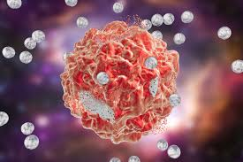
Cancer and Nanotechnology
Conventional cancer treatments(like radiation) often harm healthy cells too. Nanotechnology tries to overcome this problem.
Nanotechnology uses extremely tiny particles that can enter tumors more easily.
Tumors have leaky blood vessels, allowing nanoparticles to enter them more easily.
Once inside, nanoparticles can attach to cancer cells or release drugs directly at the tumor.

Slide 5
Benefits of Nanotechnology for Cancer
Earlier detection using highly sensitive nano-tests.
Clearer imaging scans for accurate tumor visibility.
Targeted drug delivery reduces side effects.
Can reach hard-to-treat areas.
Overall treatment becomes more effective and patient-friendly.

Slide 6
Detection and Diagnosis
Nanotechnology improves early cancer detection and diagnostic accuracy.
Nanoparticles detect cancer proteins or DNA in blood samples with high sensitivity.
Helps identify cancer earlier than normal tests.
Nanoparticles brighten tumors in MRI/CT scans.
Thus even small or hidden tumors become easier to see.

Slide 7
Measuring Response to Therapy
Nanotechnology helps monitor whether treatment is working in real time.
Some nanoparticles change their signal when cancer cells shrink or die.
Nano-blood tests detect small changes in cancer markers.
This helps doctors adjust treatment early for better results.

Slide 8
Treatment and Therapy
Chemotherapy: Nanoparticles carry chemo directly to tumors, reducing side effects.
Radiotherapy: Nanoparticles help tumors absorb more radiation.
Nano‑Immunotherapy: Nanoparticles guide immune cells to attack cancer.
Gene Therapy: Nanoparticles carry siRNA/mRNA to block harmful cancer genes.

Slide 9
Problems and Solutions
Q1: Why do healthy cells get damaged during chemo?
A:ns Traditional drugs cannot target only tumors.
Solution: Nanoparticles deliver drugs mainly to tumor cells.
Q2: Why do some cancers resist treatment?
Ans: Tumors may mutate or block drug entry.
Solution: Nanoparticles carry multiple drugs or siRNA.
Q3: Why is cancer detected late?
Ans: Early happenings of cancer cells are too small for normal tests.
Solution: Nano-biosensors detect tiny cancer markers early.
Q4: Why do cancer treatments often cause strong side effects?
Ans:Traditional drugs are not selective — they travel everywhere and can damage fast-growing healthy cells (like hair follicles, bone marrow, or stomach lining).
Solution:Nanoparticles can be engineered to release the drug only when they reach the tumor.
Q5: Why is safety a concern?
Ans: Some nanoparticles remain in organs.
Solution: Biodegradable nanoparticles reduce long‑term toxicity.

Slide 10
Conclusion
Nanotechnology is improving cancer care by making diagnosis, imaging, and treatment more precise.
Targeted nano-drug delivery reduces side effects and improves outcomes.
It also supports gene therapy, immunotherapy, and radiation enhancement.
With continued research, nanotechnology offers strong hope for safer cancer treatment in the future.

Slide 11
THANK YOU

